Slide 1
ISCHE SWG Gender
History since 1994

Slide 2
Amsterdam 1994. SWG Gender

Slide 3
SWG Gender at Montreal, 1995

Slide 4
Book of photocopied papers of the Gender Group meeting at CISH in Montreal, 1995

Slide 5
SWG on Gender papers, 1996

Slide 6
Education and Cultural Transmission edited by Johan Sturm, Jeroen Dekker, Richard Aldrich , Frank Simon. Paedagogica Historica, Supplementary Series II, (1996):
Linda A. Pollock, ‘Training a Child in the Way He/She should go. Cultural Transmission and Child –rearing within the Home in England, circa 1550-1800’, 79-103
Caroline Bowden, ‘Parental Attitudes towards the Education of Girls in late Sixteenth and early Seventeenth-Century England’, 105-24
Monique Stavenuiter, ‘Researching Adulthood. Cultural Transmission and Intergenerational Relations within the Family in The Netherlands in the Nineteenth Century’, 125-43
Leendert Frans Groenedijk, ‘Die Kulturkritische Familienpädagogik des Psychoanalytikers Wilhelm Stekels’, 145-62
Geoffrey Giles, ‘Straight Talk for Nazi Youth. The Attempt to transmit Cultural Norms’, 305-18

Slide 7
SWG Gender Krakow, 1996

Slide 8
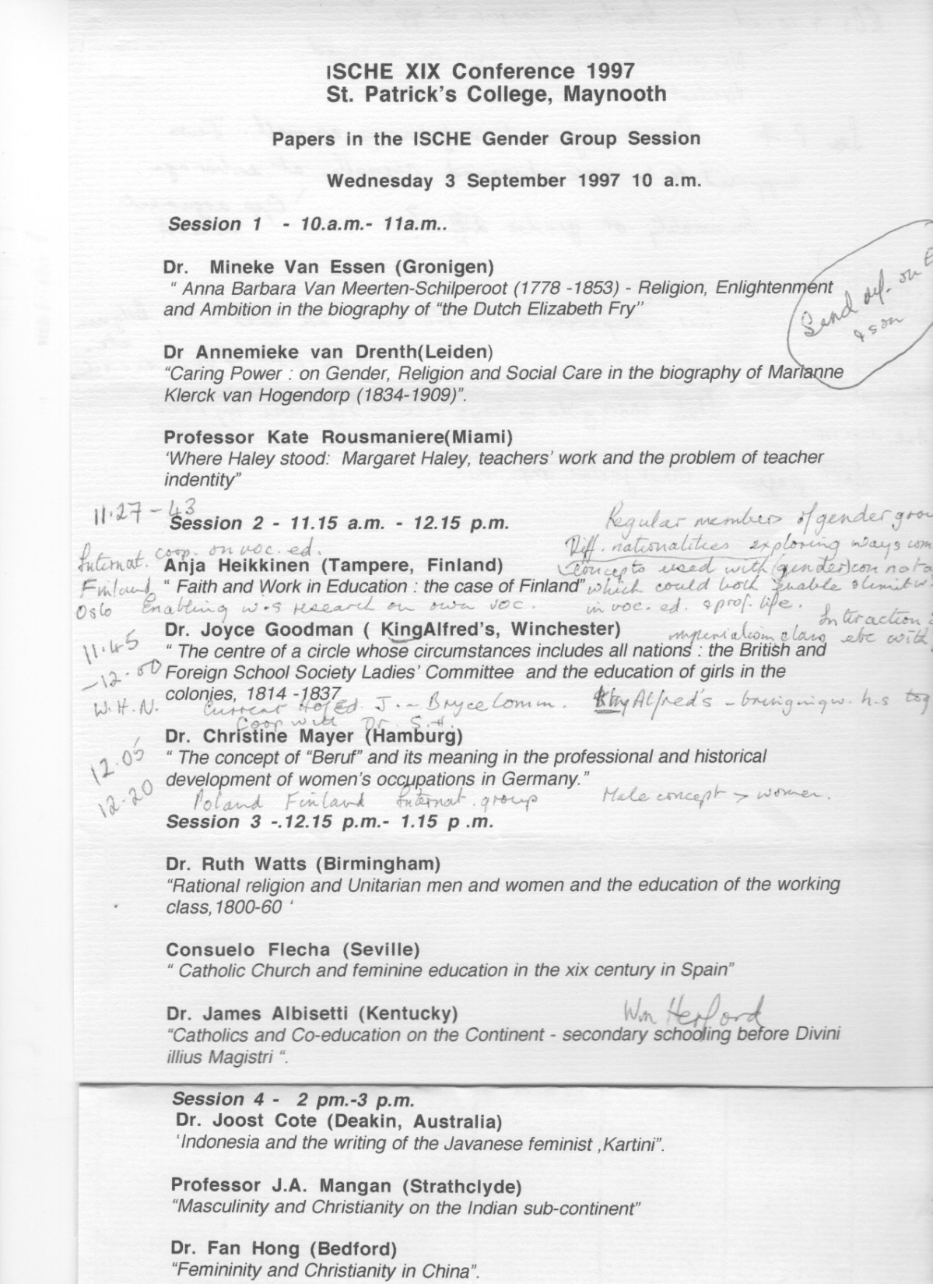

Slide 9
Leuven SWG on Gender, 1998

Slide 10
Sydney 1999; some of the gender papers

Slide 11
Paris 2002; publication in 2003 of six of the fifteen gender papers
5-35 Mineke van Essen, Rebecca Rogers, ‘Écrire l’histoire des enseignantes. Enjeux et perspectives internationales
37-60 Rebecca Rogers, ‘La sous-maîtresse français au XIXᵉ siècle: domestique ou enseignante stagiaire?
61-85 Christine Mayer, ‘La formation des institrices á Hamburg: le projet de Doris Lütkens (1846)
87-108 Andrea Jacobs, ‘Examens et professionnalisation. Les enseignantes des établissements féminins du secondaire en Angleterre, 1850-1900
109-132 Joyce Goodman, ‘Des enseignantes du secondaire dans l’Empire britannique. Identités, professionnelles, genre et mission religieuse
133-159 Mineke van Essen, ‘Des visons sexuées de la profession: les représentations des enseignantes néerlandais de l’éducation élémentaire issues de l’enquête de 1920
161-85 Josephine May, ‘Des “religieuses dans la siècle” et des hommes de ce monde. Les élèves Australiens de deux établissements d’enseignement secondaire non mixtes se souviennent de leurs professeurs (1930-1950)

Slide 12
SWG Gender Oslo, 2000

Slide 13
Gender in PH from ISCHE at Sydney in 1999 (eds. Geoffrey Sherrington & Craig Campbell) & Birmingham in 2001 (eds. Ian Grosvenor & Ruth Watts)
, Paedagogica Historica, Supplementary Series VII 37, no. 1 (2001)
Paedagogica Historica, 39, nos. 1-2 (2003)
James Albisetti, ‘European Perceptions of American Coeducation, 1865-1914: Ethnicity, religion and culture’,): 123-38
Ian D. Brice, ‘Ethnic Masculinities in Australian Boys’ Schools in late Nineteenth-Century Australia’, 139-52
Tanya Fitzgerald, ‘Jumping the Fences: Maori Women’s Resistance to Missionary Schooling in Northern New Zealand 1823-1835’, 175-92 (Awarded ISCHE prize 1999.)
Ruth Watts, ‘Mary Carpenter and India: enlightened Liberalism or condescending Imperialism?’, 193-210
Marjorie Theobald, ‘The Afghan Children of Oodnadatta: A Reflection on Gender, Ethnicity and Education in the Interwar Years’, 211-230
Kate Rousmaniere, ‘Being Margaret Haley, Chicago, 1903’, : 5-18
Joyce Goodman, ‘Sex and the City: Educational initiatives for “Dangerous” and “Endangered” Girls in Late Victorian and Early Edwardian Manchester’, 75-86
Kevin J. Brehony, ‘A “Socially Civilising Influence”? Play and the Urban “Degenerate”, 87-106
Lynne Trethewey and Kay Whitehead, ‘The City as a Site of Woman Teachers’ Post –Suffrage political Activism: Adelaide, South Australia’, 107-20
Stephanie Spencer, ‘Schoolgirl to Career Girl. The City as Educative Space’, 121-34 (Awarded ISCHE prize 2001.)

Slide 14
SWG Gender, Sydney, 2005

Slide 15
Proposal to establish a Gender Standing Working Group, 2007
Since 1994 a gender group, first as a Standing Working Group meeting outside of the main ISCHE conference and then, since 1999, meeting as an integral part of the conference, made gender accepted as a significant concept in history of education.
Twice, (at Montreal and Oslo respectively), the SWG represented ISCHE at the quinquennial International Congress of Historical Sciences (CISH). The general success of the group was such that at the conference in Sydney in 2005 it was decided that gender has become such a constituent part of ISCHE that the SWG could be disbanded. At the same time it was decided to keep a watchful eye on how gender progressed without the SWG meeting. At the following conference at Umea, a number of participants – including those who had not been in Australia – regretted the fact that the gender group was no longer meeting. It was therefore decided to reconstitute the group under the new criteria for SWGs and notice was given of this intention at the AGM.
The importance of the new Gender SWG is seen in relation to the internationally expanding scholarship on gender in history of education, investigating a range of aspects including how both femininity and masculinity have been organizing concepts in education; how male and female negotiated the social, cultural and economic structures they inhabited; and how new types of sources and approaches can be used in research on gender.

Slide 16
The aims of the Gender SWG would be:
To work towards an edited book (possibly in two volumes), demonstrating at an international level the significance of gender as an organizing concept within history of education. Within this aim the publication would consider specifically:
How conceptions of gender have affected both the range and types of education open to males and females and their subsequent life prospects.
Women as active agents and as educators in global networks in educational history.
The interrelationship of class and/or ethnicity with gender and education.
Sources and methodologies for exploring gender and education in history.

Slide 17
Proposal for a panel on Gender and Education in History for CISH, 2010
In recent decades exploring the meaning and effects of gender in history has become an essential and dynamic part of all aspects of history – social, political, economic, cultural and intellectual. The steadily expanding field of gender studies in history has moved from an emphasis on women alone, restoring them to history and questioning old narratives which ignore or marginalize them, to searches involving the significance of gender (both masculinity and femininity) as an organising concept, women’s active agency and how women and men have negotiated the social, cultural and economic structures they inhabited. This panel of four scholars from the International Standing Conference of History of Education and two chosen by the International Society of History Didactics, will view education in the widest sense, that is, the development of mental or physical powers rather than only schooling, training or systematic instruction, although the latter are, of course, included. Women as active agents and educators in global networks in history; the interrelationship of class and/or ethnicity with gender and education, the significance of education in social and cultural history and how gender has been an integral aspect of this, are leading themes for the educational historians while aspects of gender, rape law and Greek education are investigated by the other speakers. The panel will represent a wide variety of countries and continents with respect to both subjects and scholars.

Slide 18
ISCHE Gender Panel at CISH, Amsterdam 2010
Coordinators: Profs. Mineke van Essen & Ruth Watts
Discussant: Prof. Dr. Bärbel Kuhn
Panelists: Professor James Albisetti
Professor Christine Mayer
Professor Joyce Goodman
Professor Rebecca Rogers
Professor Kay Whitehead
Dr Maria Repoussi (spoke briefly, gave no paper)

Slide 19
Gender Panel, CISH 2011

Slide 20
‘Gender and Education in History’ edited by Mineke van Essen and Ruth Watts, themed issue, Paedagogica Historica, 2012
Bärbel Kuhn, ‘Gender and Education’
James Albisetti, ‘The Empress Frederick and Female Education in the Late Nineteenth Century: Germany, England, and Italy’
Joyce Goodman, ‘Women, Education and Intellectual Co-operation in the Inter-war Period’
Rebecca Rogers, ‘Language Learning versus Vocational Training: French, Arab and British Voices speak about Indigenous Girls’ Education in Nineteenth Century Colonial Algeria’
Kay Whitehead, "Transnational Connections in early Twentieth Century: Women Teachers' Work".

Slide 21
Forward by Mineke van Essen & Ruth Watts to themed issue in PH (forthcoming 2012)
The ISCHE Standing Working Group (SWG) on Gender has close connections with the International Committee of Historical Sciences (CISH/ICHS). It represented ISCHE at both the Montreal and Oslo conferences in 1995 and 2000 respectively and, in 2010, had a joint panel session with the International Society of History Didactics on the specialized theme of historical dimensions of gender and education. The session was organised and convened by the coordinators of the Gender Group, Mineke van Essen and Ruth Watts. In the event, the five papers were given by members of ISCHE SWG, although one person from History Didactics gave a short extempore address and the respondent to the papers was Professor Bärbel Kuhn. Her excellent commentary on the papers has here been turned into the Introduction while four of the papers, those by Professors James Albisetti, Joyce Goodman, Rebecca Rogers and Kay Whitehead, follow.

Slide 22
Winners of the Paper Prize with Gender Themes
1999: Tanya Fitzgerald, ‘Jumping the Fences: Maori Women’s Resistance to Missionary Schooling in Northern New Zealand 1823-1835’, PH, Supp. Series VII, 37, no.1, (2001): 175-92
2001: Stephanie Spencer, ‘Schoolgirl to Career Girl. The City as Educative Space’, P H, 39, nos. 1-2 (2003): 121-34
2002: Christine de Bellaigue, ‘Behind the School Walls: the School Community in French and English Boarding Schools for Girls, 1810-1867’, PH 40, nos. I-2 (2004): 106-21
2005: Helen Proctor, ‘Gender and Merit: Coeducation and the Construction of a Meritocratic Educational Ladder in New South Wales, 1880-1912’, PH 43, no. 1 (2007): 119-34
2007: Siân Roberts, ‘Exhibiting Children at risk: Child Art, International Exhibitions and Save the Children Fund in Vienna, 1919-1923’, PH, 45, nos. 1&2 (2009): 171-90;
2009: Amy Palmer, ‘Nursery Schools for the Few or the Many? Childhood, Education and the State in mid-Twentieth –century England’, PH, 47, nos. 1&2 (2011): 139-54

Slide 23
Annemieke van Drenth, ed. ‘Gender and Politics in the History of Education’, Paedagogica Historica 44, no.4 (2008)
Annemieke van Drenth, ‘Contested Scripts: an Introduction’, Paedagogica Historica 44, no.4 (2008): 369-77.
Annemieke van Drenth & Mineke van Essen, ‘The Ambiguity of Professing Gender: Women Educationists and New Education in the Netherlands (1890-1940), 379-96
Jane Martin, ‘Engendering city Politics and Educational Thought: Elite Women and the London Labour Party, 1914-1965’, 397-413
Joyce Goodman, ‘Conservative Woman or Woman Conservative? Complicating Accounts of women’s Educational Leadership, 415-28

Slide 24
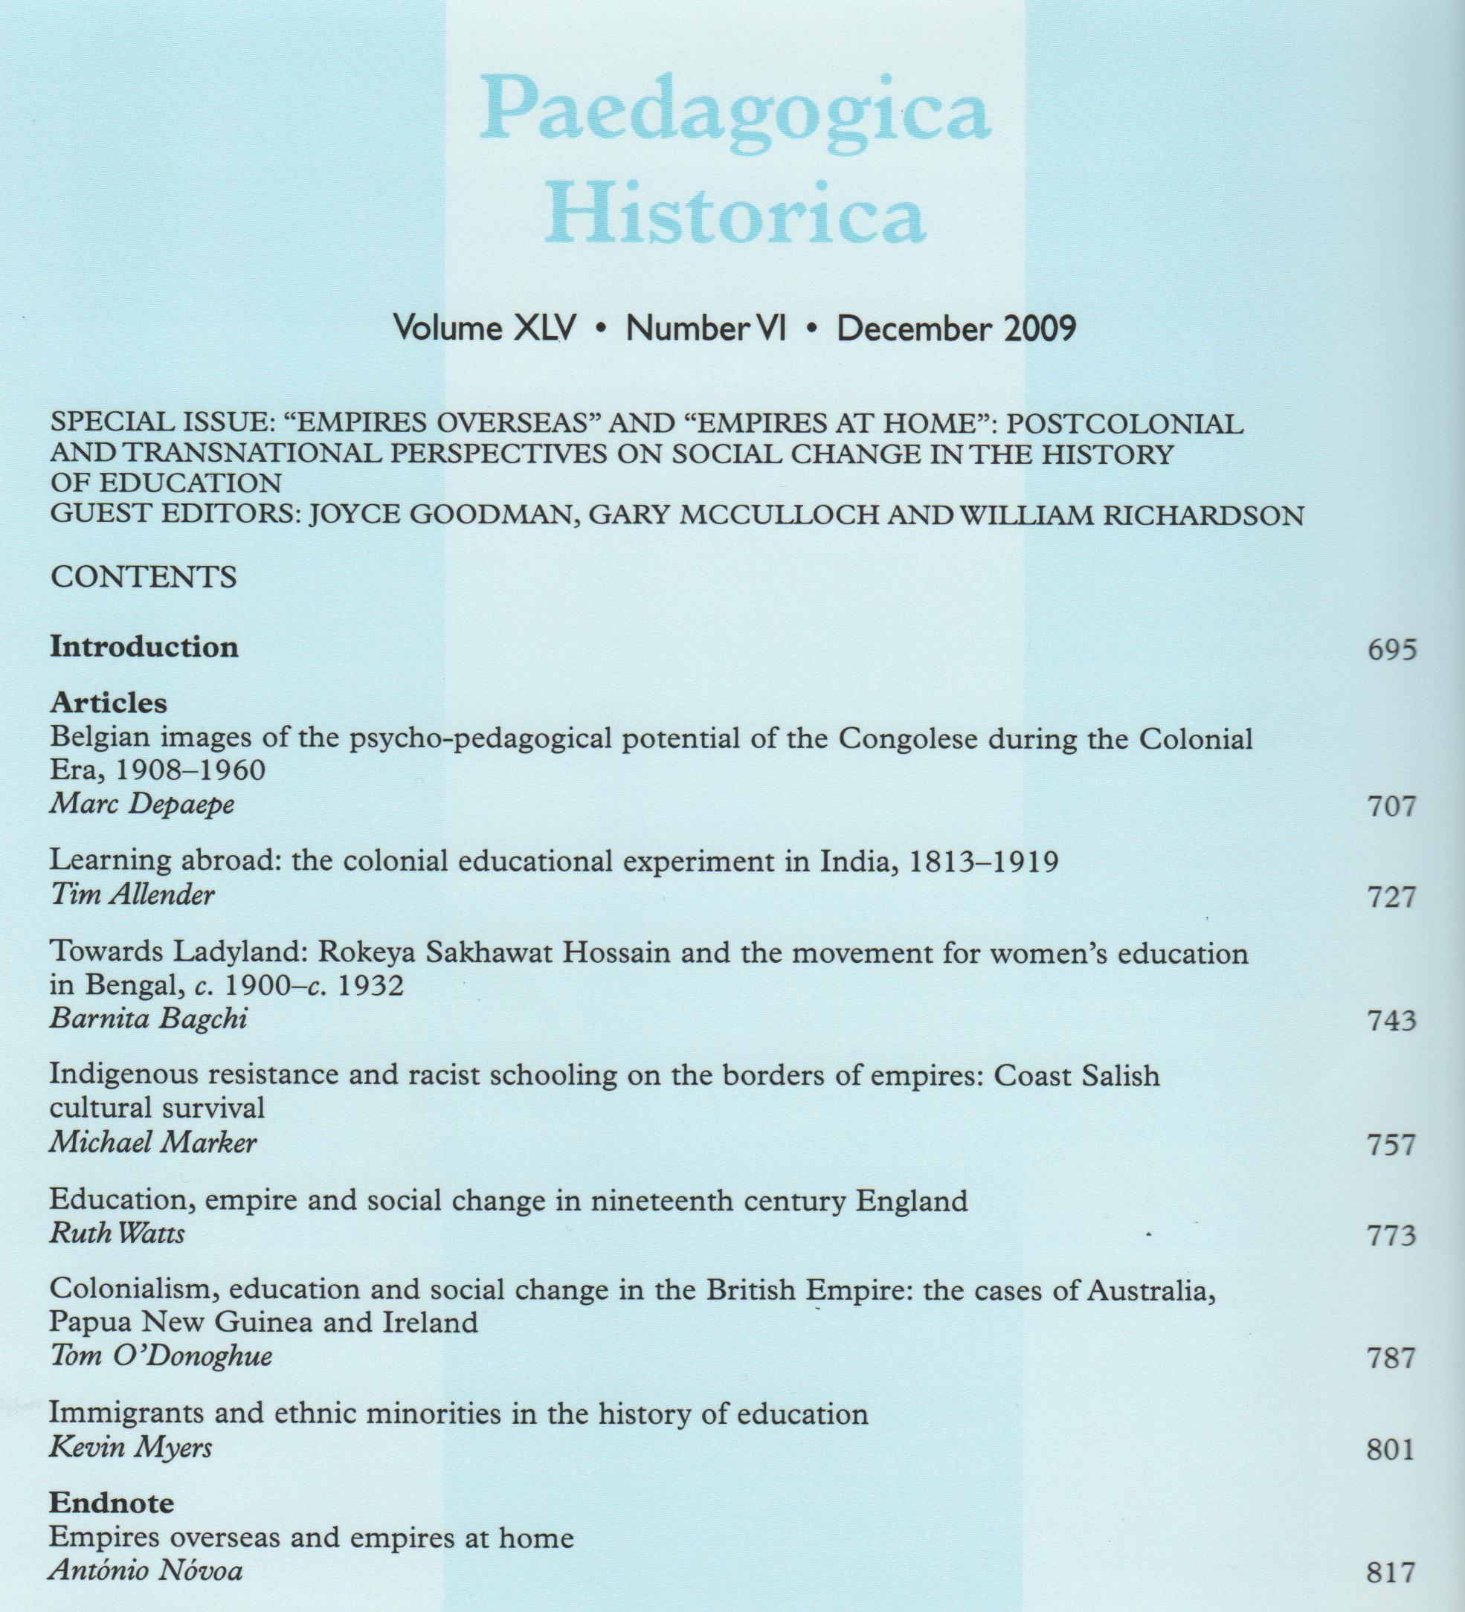

Slide 25
Annemieke van Drenth, ed. ‘Gender and Politics in the History of Education’, Paedagogica Historica 44, no.4 (2008)
Annemieke van Drenth, ‘Contested Scripts: an Introduction’, Paedagogica Historica 44, no.4 (2008): 369-77.
Annemieke van Drenth & Mineke van Essen, ‘The Ambiguity of Professing Gender: Women Educationists and New Education in the Netherlands (1890-1940), 379-96
Jane Martin, ‘Engendering city Politics and Educational Thought: Elite Women and the London Labour Party, 1914-1965’, 397-413
Joyce Goodman, ‘Conservative Woman or Woman Conservative? Complicating Accounts of women’s Educational Leadership, 415-28

Slide 26
Gender and Class
Christine Mayer, ‘Social Change and Educational Reform Illustrated by the Development of the School of Industry in Hamburg, 1788-1811’, Paedagogica Historica, Supplementary Series IV (1998): 88-104
Christine Mayer, (2011) 'Poverty, education and gender: pedagogic transformations in the schools for the poor (Armenschulwesen) in Hamburg, 1788-1871', Paedagogica Historica, 47, nos. 1&2 (2011): 91-107
Luis Grosso Correia, ‘Social Patters of Literacy in the City of Porto at the End of the Nineteenth Century’, Paedagogica Historica, 44, nos. 1&2 (2008): 83-105

Slide 27
Gender in Internationalism and Transnationalism
Joyce Goodman, ‘Working for Change across International Borders: the Association of Headmistresses and Education for International Citizenship’, Paedagogica Historica, 43, no. 1 (2007): 165-80
Christa Kersting, ‘Weibliche Bildung and Bildungspolitik: das International Council of Women und seine Kongresse in Chicago (1893), London (1899) und Berlin (1904), Paedagogica Historica 44, no.4 (2008): 327-46
Siân Roberts, ‘”I promised them that I would tell England about them”: a woman teacher activist’s life in popular humanitarian education’, Paedagogica Historica, 47, nos.1&2 (2011), 155-72
Kay Whitehead and Judith Peppard, ‘Transnational Innovations, Local Conditions and Disruptive Teachers and Students in Interwar Education’, Paedagogica Historica, 42, nos. 1&2 (2006): 177-89

Slide 29
Some Paedagogica Historica issues where gender implicit
Paedagogica Historica 43, no.4 (2007)
Paedagogica Historica 46, no.6 (2010).
Special issue on ‘Servants, Domestic Servants and Children, the Role of Domestic Personnel in the Upbringing and Education of the Master’s and Employer’s Children from the Sixteenth to the Twenty-First Centuries’ edited by Patrizia Delpiano and Raffaella Sarti
Special issue on ‘Politics of Child Care in Historical Perspective. From the World of Wet Nurses to the Networks of Family Child Care Providers’ edited by Véronique Pache Huber and Véronique Dasen

Slide 30
Amsterdam, 1994. Child Rearing and Child Development.

Slide 31
Gender Group conviviality at ISCHE

